Slide 1



Final Project DS 18
Credit Default Prediction
Suci Rahma Nura
Juni 2023

Slide 2

Indonesia's non-performing loan (NPL) ratio in April 2023 was reported to have increased by 2.5% from March 2023, with an average ratio increase from January - March 2023 of 3.0%.
Info by ceicdata.com

Slide 3
What is NPL ?

Slide 4
A nonperforming loan (NPL) is a loan in which the borrower is in default and hasn't made any scheduled payments of principal or interest for a certain period of time.

Slide 5
NPLs for Financial Institutions are a sign of unsound business management. If these circumstances do not change, the impact may worsen the economic situation of the nation.

Slide 6
NPLs will also have a direct impact on the Credit Adequacy Ratio (CAR), or the adequacy of banking capital to cope with various risks that may occur. The decline in credit turnover causes banks to cover their capital needs with their own capital, thus reducing their CAR.

Slide 7
Seeing the magnitude of the impact that will be caused by NPLs, every financial institution should have its own strategy to avoid this. One strategy that is very possible to do is to create a better prediction model, so that the company can avoid these losses..

Slide 8
So, let’s check our
‘Credit Default Prediction ’!

Slide 9
Table of Contents
Data Understanding and Exploratory Data Analysis
Data Preprocessing
Modelling with Balance Data
Dalex
Business Case and Recommandation
Appendix

Slide 10

Objective
What kind of debtors have a tendency to default?
What variables affect the risk of default the most?
What machine learning models are suitable for predicting debtors defaults?
What impact will the model have on the business?

Slide 11
Data Understanding

Slide 12
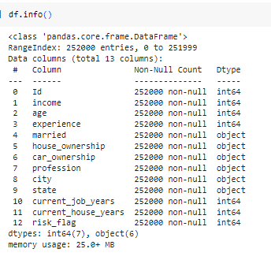
Data Understanding
This dataset is obtained from a Hackathon. https://www.kaggle.com/datasets/gargvg/univai-dataset?select=univ.ai_Training+Data.csv
This dataset has 12 columns and 252000 rows
Target feature : ‘risk_flag’
No missing and duplicate values

Slide 13
Exploratory Data Analysis

Slide 14
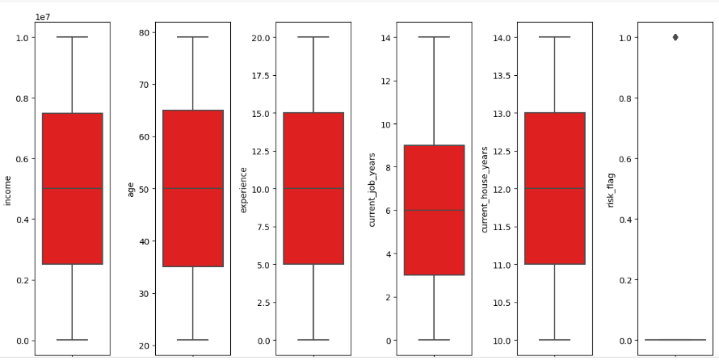
EDA
We can see, that risk-flag is the only column that has outliers and it reasonable, since it only has 2 unique value ( 0 and 1). So we can say that there are no outliers in this dataset.

Slide 15
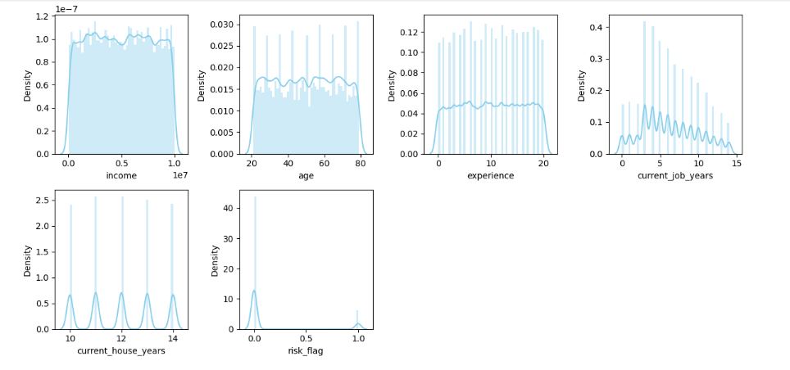
EDA
Somehow, the columns are not simetrical, but not skew either

Slide 16
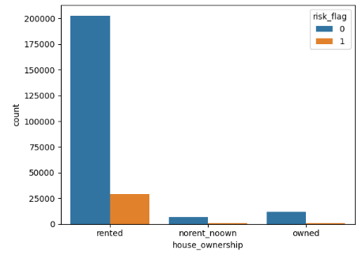
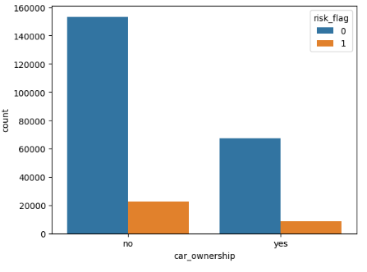
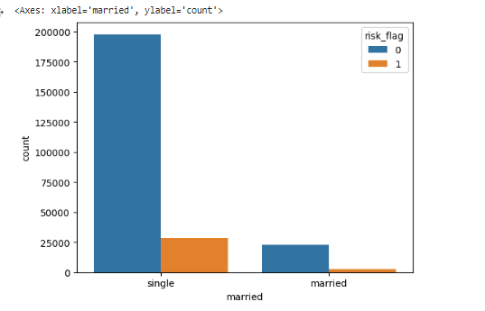
EDA
Based on this graph, debtors who are single, live in a rented house, and are not car owners have a higher risk of default than those who are married, live in their own house and own a car.
notes : blue bars indicate non-risky debtors and orange bars indicate high-risk debtors.

Slide 17
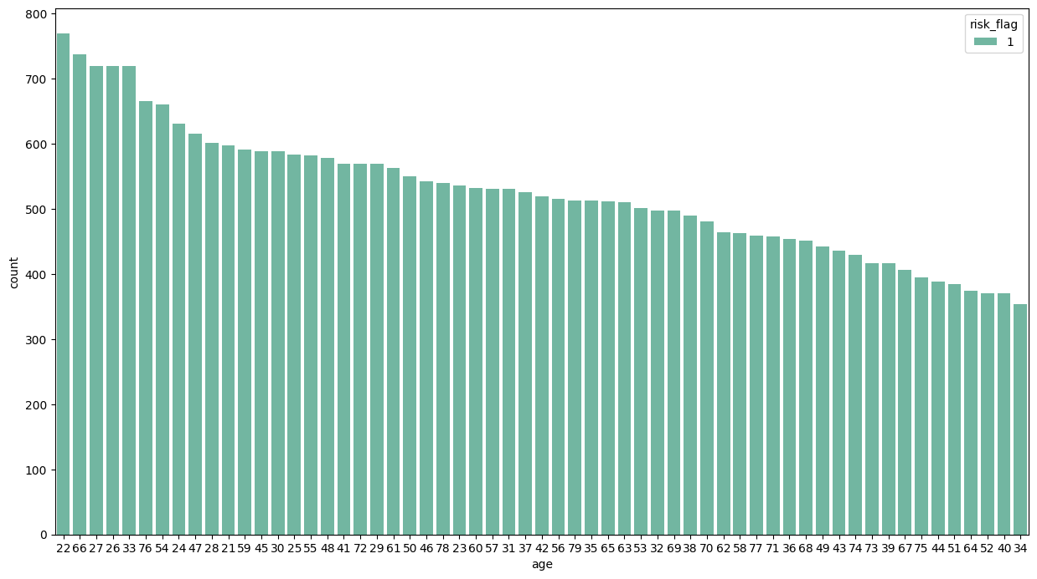
EDA
There is no visible risk in certain age groups, which means that any age can be at risk of default.

Slide 18
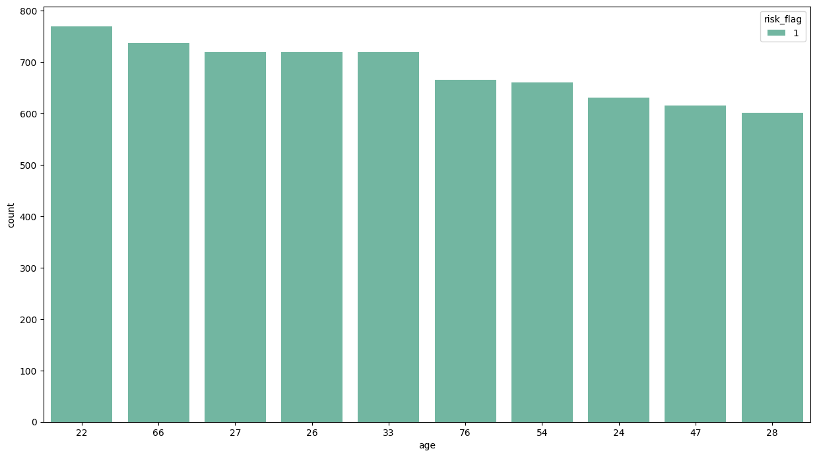
EDA
But, If we take the 10 ages with the highest risk, we can see that the 20s are more at risk than other ages.

Slide 19
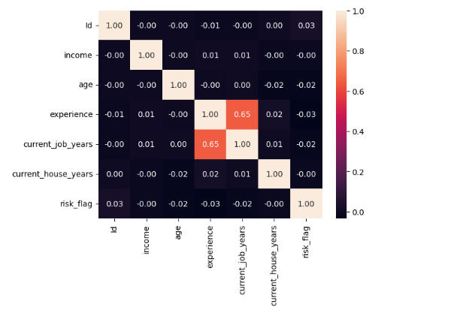
EDA
Multivariate Analysis
Based on the heatmap above, experience and current_job_years have a stronger correlation than the others, although the correlation is only 0.65, still < 0.7.

Slide 20
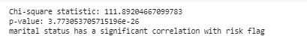
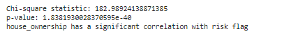
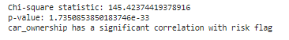
EDA - Chi Square Test
The chi square test was conducted on categorical data such as married, house_ownership, and car_ownership. The result is that the variables married, house_ownership, and car_ownership have a fairly strong correlation with the variable risk_flag.

Slide 21
Data Pre Processing

Slide 22
Data Pre Processing
In this case the methods that will be used are :
One hot coding for the variables married and car_ownership.
Frequency coding for the profession, city, and state variables.
Scaling on the age variable, experience variable, current_job_years, and current_house_years.

Slide 23
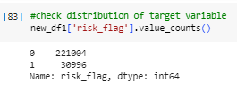
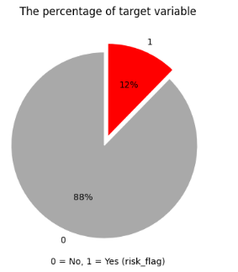
Handling Imbalance
This dataset has a fairly imbalanced amount between risk_flag that is worth 1 and risk_flag that is worth 0, for that we need to do imbalance handling using smote.

Slide 24
Modelling with Balance Data

Slide 25
Model with Balance Data
Machine learning model to be tested are :
1. Logistic Regression
2. Decision Tree
3. KNN
4. Random Forest
5. Gaussian Naive Bayes
6. Gradient Boosted Tree

Slide 26
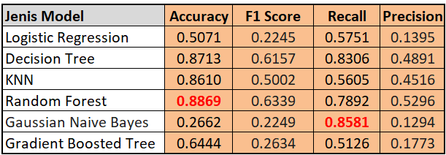
Model with Balance Data
Because this data set is a credit risk classification case and the data is balanced, we will focus on the recall and accuracy evaluation matrix. The following is a recap of the model values:
The accuracy value of Random Forest is higher than the recall of Gaussian Naive Bayes, so we will use Random Forest as the model because it has the highest evaluation matrix value.

Slide 27


88.69%
Based on the test results of several methods, the best model is Random Forest using matrix evaluation Accuracy with an evaluation rate is 88.69%.

Slide 28
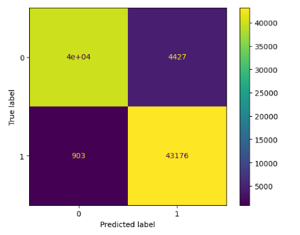
Confusion Matrix
4427 means 4427 not high risk that predicted as high risk.
903 means 903 have high risk that predicted as not high risk.
4e+04 means 4e+04 that correctly predicted as not high risk
43176 means 43176 that correctly predicted as high risk.

Slide 29
Dalex

Slide 30
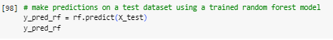
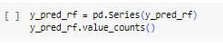
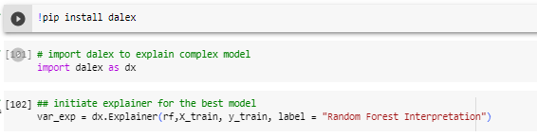
Dalex
Next, we will use dalex to see which variables are most highly correlated with the target variable after data processing.

Slide 31
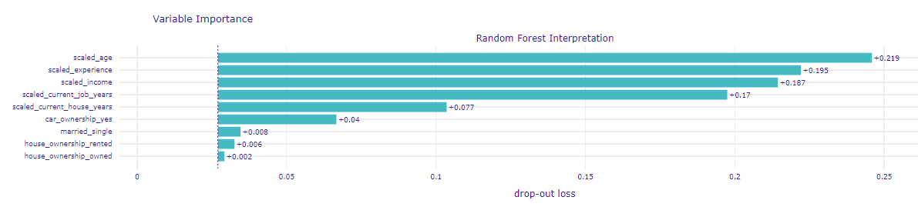
Dalex
Based on the barplot above, age, income, `current job years, and experience have a high effect on the risk flag. And age has the highest effect.

Slide 32
Business Case

Slide 33
"How much will this model impact the company?"

Slide 34
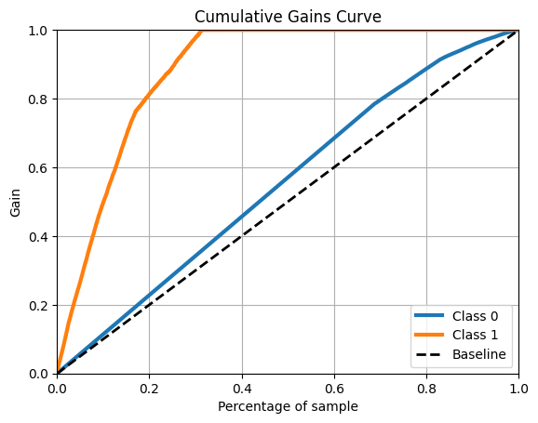
To find out we will use Cummulative Gain Curve
We can say that the results of the plot_cumulative_gain are good, for example, if we take a sampling of 0.2, then we have got in Class 1 is 0.8, which means 4x better performance than we do not use the model (baseline).
notes : The baseline on this curve is not the model baseline, but a prediction made without the model.

Slide 35

Final summary
Debtors who are unmarried, live in a rented house, and do not own a car are very risky to finance.
Variables that have a high effect on credit risk are customer age, married status, home ownership and car ownership.
In this case, the model using Random Forest with Accuracy evaluation matrix has the best performance, with an evaluation of 88.69%.
With a high level of evaluation, of course this prediction also has a high impact on business, at least it can help reduce losses > 88%.

Slide 36
Business Recommandations
Avoid financing debtors who are unmarried, live in a rented house, do not own a car, aged between 20s years old.
However, if you still want to finance debtors with these categories, you may be able to submit additional data such as additional income, proof of ownership of other assets, or a guarantor from the family who is able and willing to take financial responsibility.

Slide 37
Appendix

Slide 38
Here are some of the methods I used to find the best model
- One Hot Encoding for Married, home ownership, car ownership
- Frequency Encoding for Profession, city, state
- One Hot Encoding for Married, car ownership
- Weight of Evidence (WoE) Encoding for Profession, city, state, home ownership
- One Hot Encoding for Married, home ownership, car ownership
- Frequency Encoding for Profession, city, state
Do standard scaller for all numerical data
( this methode has the best model )
- One Hot Encoding for Married Married, car ownership
- Weight of Evidence (WoE) Encoding for Profession, city, state, home ownership
- Do standard scaller for all numerical data
Do the method repeatedly for balance and imbalance data, and also use other matrix evaluations such as Accuracy, F1 score, Recall and Precision on each method to see which evaluation matrix is better.

Slide 39
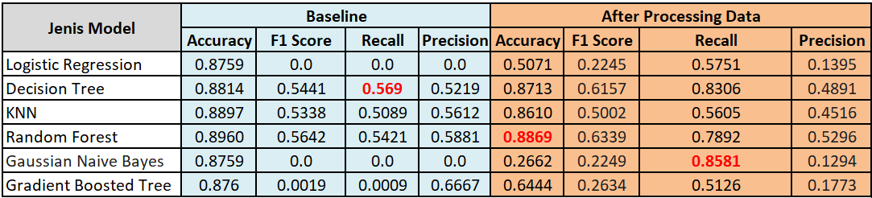
Comparison between baseline and model after data processing

Slide 40
Refferences
https://medium.com/responsibleml/visualize-ml-model-bias-with-dalex-b63f182cd649
https://medium.com/@pararawendy19/memahami-metrik-pada-pemodelan-klasifikasi-29cd5b738ee7
https://ksnugroho.medium.com/confusion-matrix-untuk-evaluasi-model-pada-unsupervised-machine-learning-bc4b1ae9ae3f
https://www.ceicdata.com/id/indicator/indonesia/non-performing-loans-ratio
https://www.idscore.id/faq/detail/apa-itu-non-performing-loan-npl-serta-dampak-negatif-bagi-lembaga-keuangan

Slide 41
Thank you very much!
Final Project Report
Data Science Bootcamp Batch 18
dibimbing.id

